Slide 1
Debugging

Slide 2
Outline
Types of Errors
Compilation/Syntax errors
Run-Time errors
Logical errors
Debugging techniques to locate logical errors
2

Slide 3
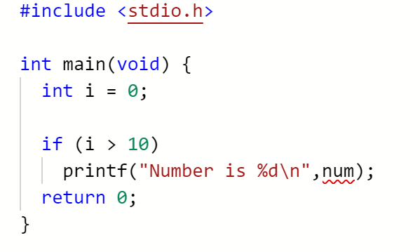
Types of Errors – Syntax Errors
Type 1. Compilation/Syntax Errors
The errors that are detected during the compilation of the program
repl.it and other C environments can usually highlight these errors
Move your mouse cursor over the squiggly lines to get more info about the error.
Note: Sometimes the errors may appear before the indicated line.

Slide 4
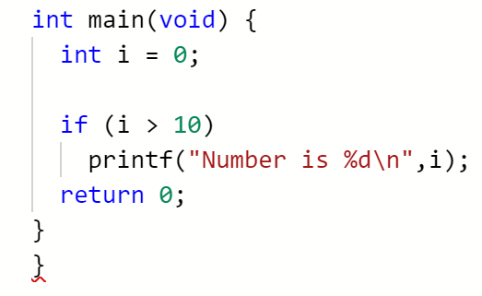
Types of Errors – Syntax Errors
Type 1. Compilation/Syntax Errors
Common syntax errors:
Duplicated variable names
Missing semi-colons ;
Mismatched braces { }
Mismatched quotes ""
…("…)"…
…('…")…
…("…,"…)…
This is called a dangling brace.

Slide 5
Types of Errors – Run-time Errors
Type 2. Run-Time Errors
The errors occur while the program is running and cause the program to crash.
Common run-time errors:
Division by zero
Array index out of bound
The consequence of the array index out of bound error is unpredictable;
The program may crash (run-time errors), or
Some variables may get modified unknowingly (the program does not crash).
1
2
3
4
int a, b;
a = 3;
b = 0;
printf("%d\n", a / b);
1
2
3
int array[10] = { 0 };
array[10] = 50;
printf("%d\n", array[1000]);

Slide 6
Types of Errors – Logical Errors
Type 3. Logical Errors: the result is unexpected!
Not syntax errors or run-time errors.
i.e., the program can be compiled and executed successfully.
But, the program logic is wrong.
Source of errors: (1) Typo.
Valid C statement, but wrong meaning
Using %d instead of %lf when the variable is of type double
1
2
3
4
double a;
scanf("%d", &a);
if (a = 1)
...
Using = instead of == when checking for equality

Slide 7
Types of Errors – Logical Errors
Source of errors: (2) Incorrect program logic.
This is the most frustrating moment!
Because we usually spend most of the programming time in discovering where the error is.
Don’t give up yet!
We have systematic ways to locate logical bugs.

Slide 8
How to Locate a Logical Error?
The output of this program is incorrect.
How should we approach to find the bug?
1
2
3
4
5
6
7
8
9
101112
// A program to convert temperature in degree Fahrenheit
// to equivalent degrees in Celsius and Kelvin.
double F, C, K; // Fahrenheit, Celsius, Kelvin
scanf("%lf", &F);
C = 5 / 9 * (F – 32);
K = C + 273.15;
printf("%.2lfF = %.2lfC = %.2lfK\n", F, C, K);
The first bug in computer history

Slide 9
How to Locate a Logical Error?
Every statement computes in the following manners
Base its computation on the value of some variable(s)
Update the value of some variable(s)
1
2
3
4
5
6
7
8
9
101112
// A program to convert temperature in degree Fahrenheit
// to equivalent degrees in Celsius and Kelvin.
double F, C, K; // Fahrenheit, Celsius, Kelvin
scanf("%lf", &F);
C = 5 / 9 * (F – 32);
K = C + 273.15;
printf("%.2lfF = %.2lfC = %.2lfK\n", F, C, K);
Use the value of F to compute, and update the value of C.

Slide 10
How to Locate a Logical Error?
If a variable is assigned a wrongly computed value, subsequent computations will likely produce wrong results.
1
2
3
4
5
6
7
8
9
101112
// A program to convert temperature in degree Fahrenheit
// to equivalent degrees in Celsius and Kelvin.
double F, C, K; // Fahrenheit, Celsius, Kelvin
scanf("%lf", &F);
C = 5 / 9 * (F – 32);
K = C + 273.15;
printf("%.2lfF = %.2lfC = %.2lfK\n", F, C, K);
If C is assigned a wrong value here, then subsequently the value of K and the output will be affected.
How do we find out if C's value is wrong?

Slide 11
How to Locate a Logical Error?
Variables usually hold some clues to the bug.
One way to inspect variables is to output their values.
1
2
3
4
5
6
7
8
9
101112
// A program to convert temperature in degree Fahrenheit
// to equivalent degrees in Celsius and Kelvin.
double F, C, K; // Fahrenheit, Celsius, Kelvin
scanf("%lf", &F);
C = 5 / 9 * (F – 32);
printf("DEBUG: C = %.2lf\n", C); // Check C's value
K = C + 273.15;
printf("%.2lfF = %.2lfC = %.2lfK\n", F, C, K);

Slide 12
How to Locate a Logical Error?
(Even better) Use a variable to control whether debug messages should be printed
Can suppress debug messages in final version (e.g., Replit submission)
1
2
3
4
5
6
7
8
9
101112
13
14
// A program to convert temperature in degree Fahrenheit
// to equivalent degrees in Celsius and Kelvin.
double F, C, K; // Fahrenheit, Celsius, Kelvin
int debug = 1; // Change this to 0 in final version
scanf("%lf", &F);
C = 5 / 9 * (F – 32);
if (debug)
printf("DEBUG: C = %.2lf\n", C); // Check C's value
K = C + 273.15;
printf("%.2lfF = %.2lfC = %.2lfK\n", F, C, K);

Slide 13
Narrowing Down the Range
If you find that you have too many lines of code and not sure where to insert printf(), you may comment out later parts of the program first
// calculations…
// output… CHECK HERE
/*
// some more calculations…
// some more output…
// even more calculations…
// even more output…
*/
// calculations…
// output…
// some more calculations…
// some more output…
// CHECKED OK!
// even more calculations…
// even more output…
// CHECK HERE
// calculations…
// output… CHECKED OK!
// some more calculations…
// some more output…
// CHECK HERE
/*
// even more calculations…
// even more output…
*/

Slide 14
Steps in Locating Logical Errors
Insert “print” statements to important locations of a selected range of problematic code.
Print out values of important variables.
Do you see unexpected values?
Narrow down the range of problematic codes.
YES
NO
NO
Can you locate the bug?
Need to print more variables out.
YES

